Slide 1
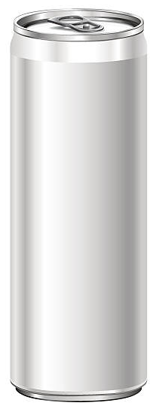

Codex
Energy Drink
Marketing Insights

Slide 2

Introduction
CodeX is a German beverage company that is aiming to make its mark in the Indian market. A few months ago, they launched their energy drink in 10 cities in India.
Their Marketing team is responsible for increasing brand awareness, market share, and product development.
They conducted a survey in those 10 cities and received results from 10k respondents.
Me, Peter Pandey, a marketing data analyst took the challenge to convert these survey results to meaningful insights by which our team can use to drive actions to the F&B Industry.

Slide 3
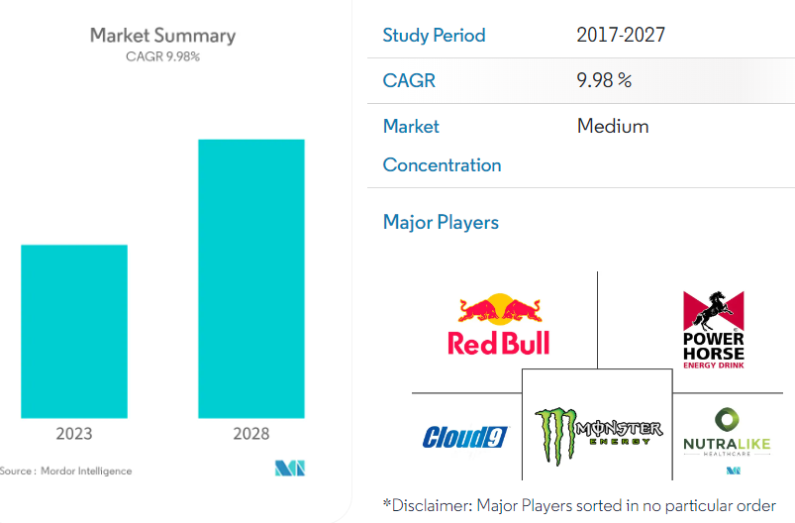
Energy Drink – Market Analysis
Indian Energy drink market is projected to register a CAGR of 9.98% over next 5 years.
Energy drinks are gaining massive popularity among millennials due to aggressive marketing campaigns targeting young consumers.
Increased urbanization, rising disposable income, and growing health consciousness among the Indian youth have increased the demand for non-carbonated drinks called energy drinks.
At the same time, long and erratic working hours and the increasing occurrence of social gatherings are driving Indian consumers toward consuming energy drinks, which are primarily classified as non-alcoholic, caffeinated, and sports drinks.

Slide 4
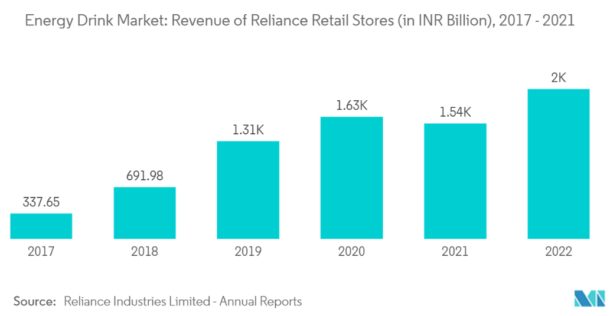
Energy Drink – Trends & Forecasts
Goldwin Healthcare, Power Horse Energy Drinks GMBH, Monster Beverage Corporation, Nutra like Health Care, Red Bull GMBH are the major companies operating in India Energy Drink Market.
The India beverages market size was valued at 49.66 billion liters (BL) in Q4 2022. The country’s GDP is expected grew in Q4 2022, despite surging energy and food prices. High annual inflation created headwinds for many categories, as low-income households reduced purchases of non-essential items.
Low-priced beverages such as nectars, fruit powders, and still drinks performed well, despite their high sugar content. The rise in tourism and family gatherings during festivals such as Diwali and Christmas benefited both on-premise and at-home consumption.

Slide 5
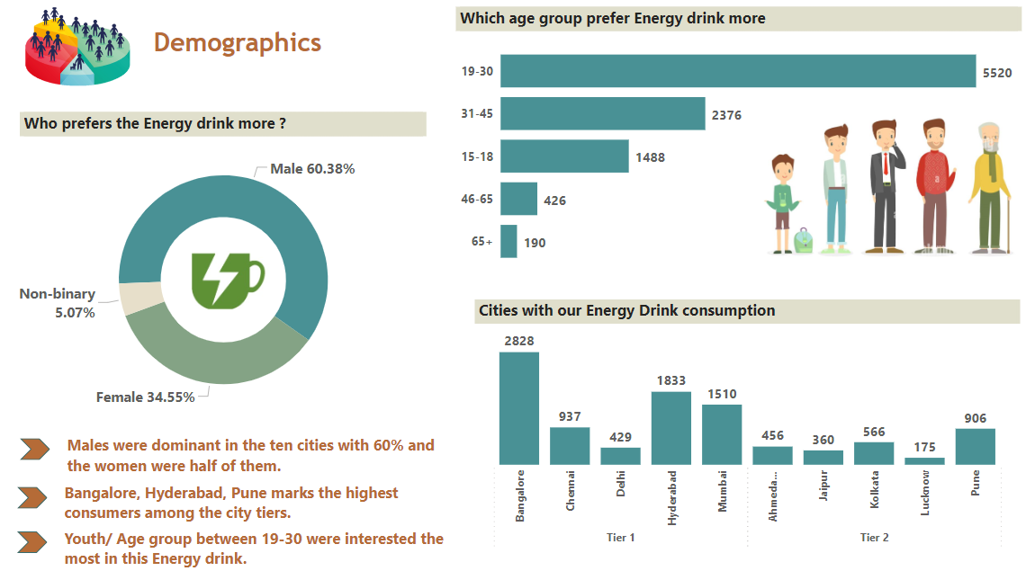

Slide 6
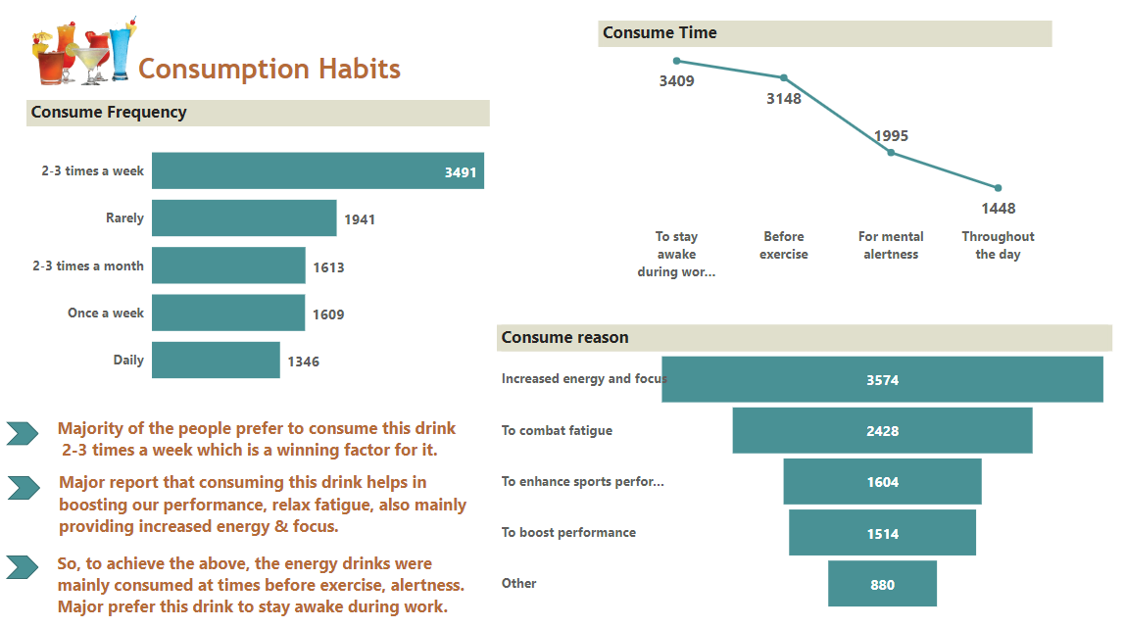

Slide 7
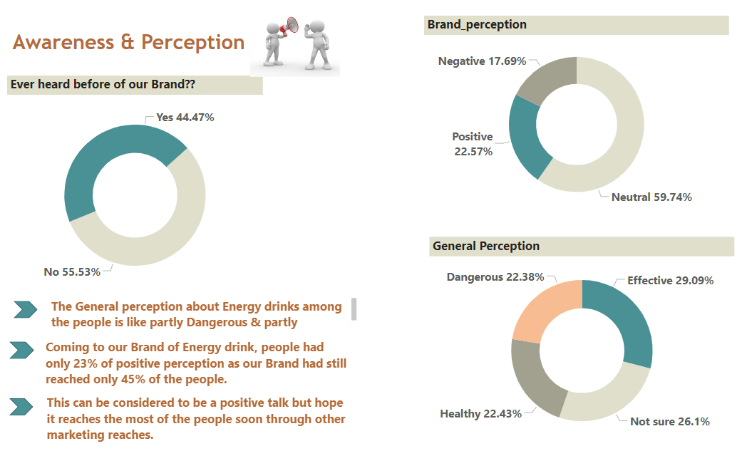

Slide 8
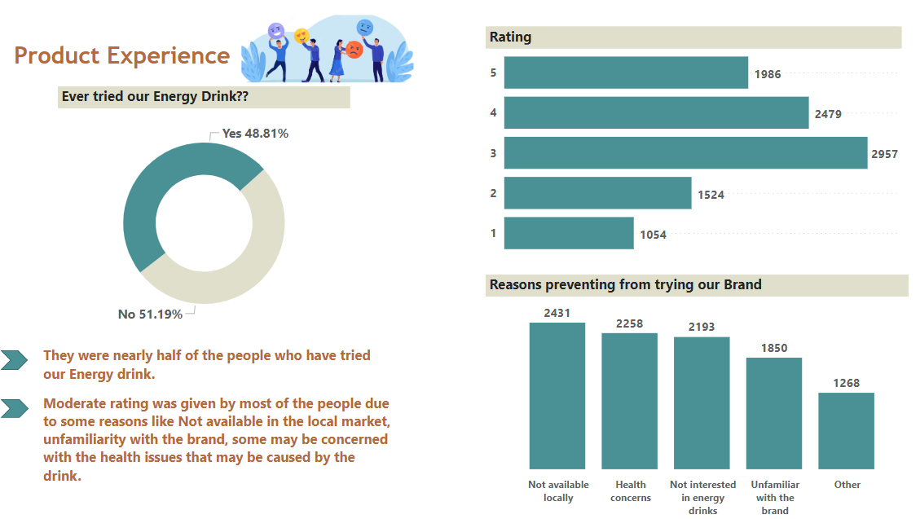

Slide 9
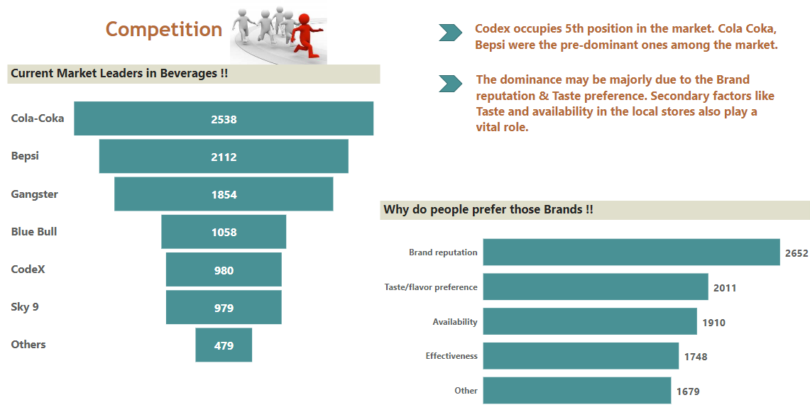

Slide 10
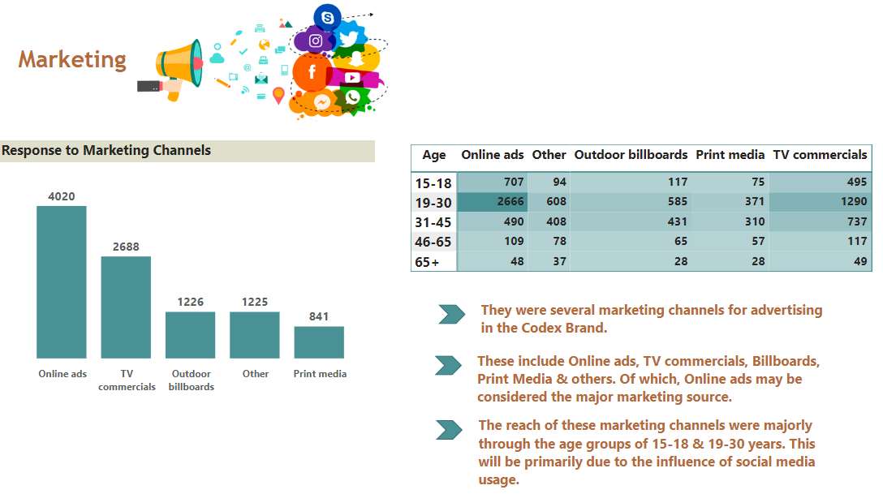

Slide 11
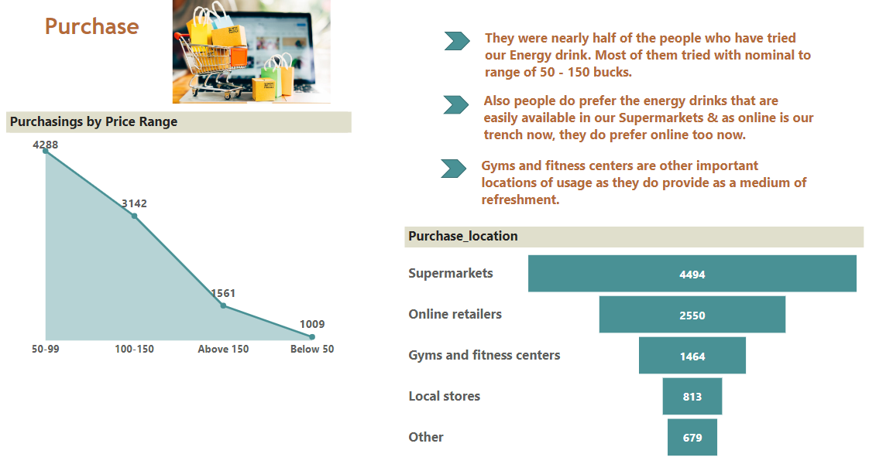

Slide 12
